Slide 1
Reverse Geocoding

Slide 2
Hello!
I am Abhishek Nayak
Currently pursuing my graduation from ABIT Cuttack in B-Tech of Branch CSE
Today the topic of my presentation is all about Reverse Geocoding.

Slide 3
Content
Steps to Fetch and
Display map
Disadvantages
Conclusion
End
2
4
6
8
Introduction
1
3
5
7
Advantages
Future Scope
References

Slide 4
Introduction
Geocoding is the process of transforming a description of a location such as a pair of coordinates, an address, or a name of a place.
Geocoding are up of two types :
1. Forward Geocoding
2. Reverse Geocoding
Forward Geocoding means you start with an address or location (such as India) and end up with latitude and longitude coordinates.
Reverse Geocoding is a process used to convert coordinates (latitude and longitude) to human-readable addresses.

Slide 5
Steps to fetch and display
GET COORDINATES
(Latitude coordinate , Longitude coordinate)
TRANFORM INTO PROPER FORMAT
Storing the coordinates into a single array by destructing
PASS TO API URL
Using template literals passing those coordinates to get the response from API
GET THE RESPONSE
Waiting for the promise to fulfil and if reject then pass to catch state or else returns a response with status “ok”
CONVERT TO JSON
The data which we get is not easily readable so we convert them to json to use that data in our application
GET MAP
After passing that data to our component we basically renders the map on the screen.

Slide 6
Leaflet API
HOME

Slide 7
Advantages
Easy to use and Implement.
The user does not need to maintain and update the referenced database.
The user can get immediate location results.
No extra software or tool is required on the user side to get the results.

Slide 8
Disadvantages
Without Internet connection it is not possible for a user to get the desired result.
While the conversion process from coordinates to a proper location there may be a chance that the same area name or location name may be present twice or more in that state or country.

Slide 9
Future Scope
Now a day most of the websites and even applications uses this reverse geocoding techniques like Amazon, Flipkart , Google Maps, Zomato , Swiggy etc. to know the exact location of the user and send their product to that location.

Slide 10
Conclusion
So here I conclude that in future a lot of upcoming companies and startups will be using this technique to get the users exact location and perform any operation with that resulted location.

Slide 11
References
https://geocode.xyz/ [ Used for Conversion API]
https://leafletjs.com/ [Used for Displaying map]
[Project Source Code Link]
[See Live Project]

Slide 12
Thank You!

Slide 13
Quotations are commonly printed as a means of inspiration and to invoke philosophical thoughts from the reader.

Slide 14
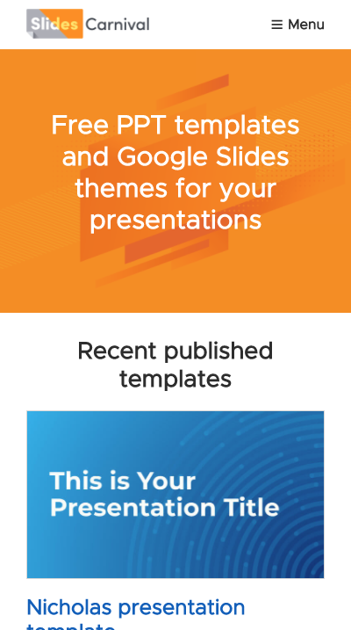
Mobile project
Show and explain your web, app or software projects using these gadget templates.

Slide 15
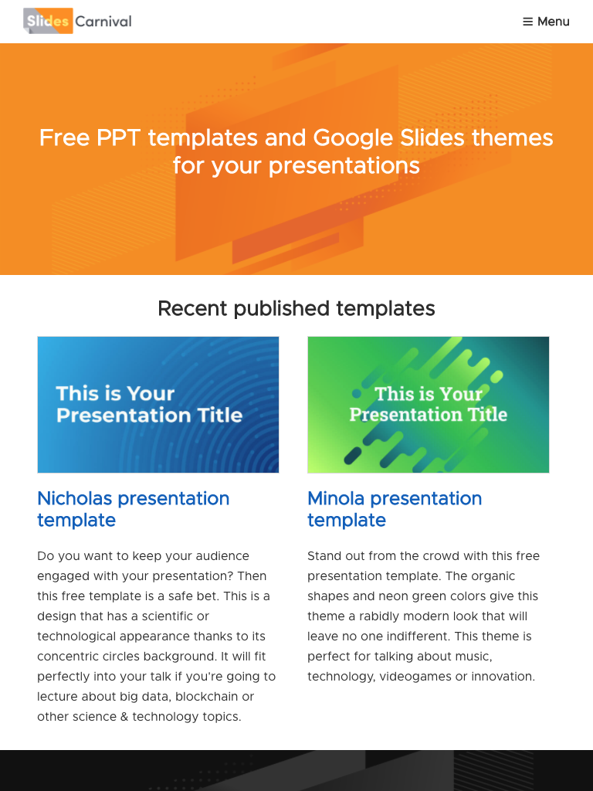
Tablet project
Show and explain your web, app or software projects using these gadget templates.

Slide 16
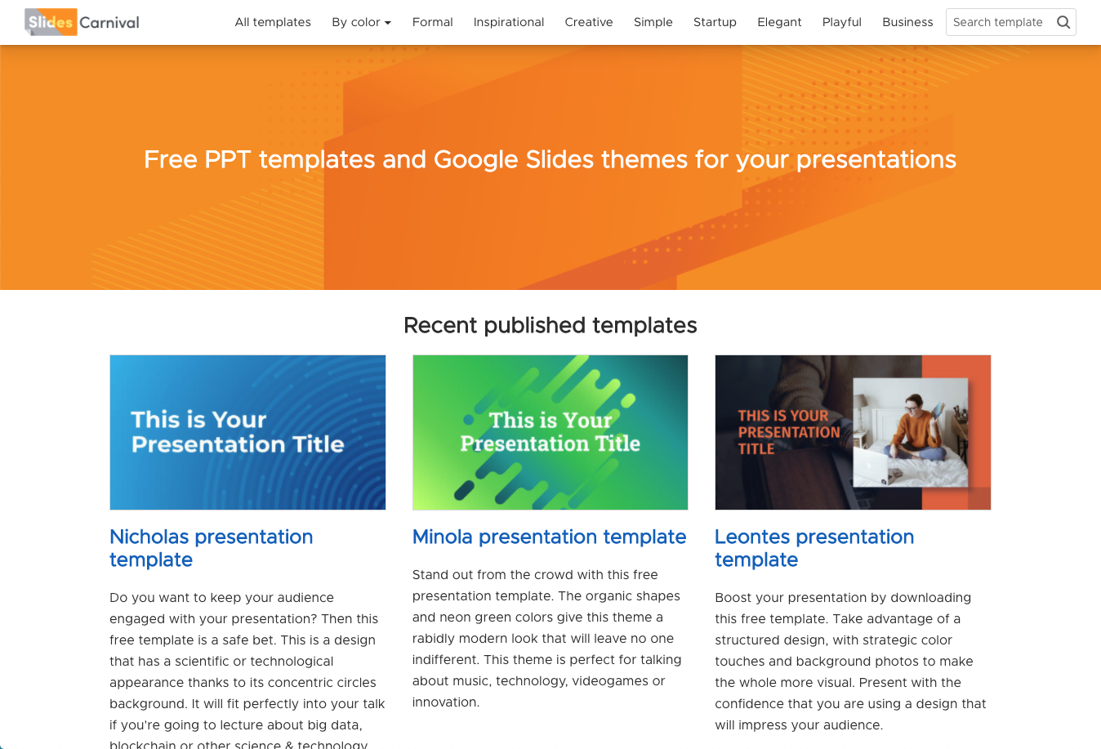
Desktop project
Show and explain your web, app or software projects using these gadget templates.

Slide 17
thanks!
@username user@mail.me
Any questions?

Slide 18
SlidesCarnival icons are editable shapes. This means that you can:
Resize them without losing quality.
Change fill color and opacity.
Change line color, width and style.
Isn’t that nice? :) Examples:
Find more icons at slidescarnival.com/extra-free-resources-icons-and-maps

